Slide 1
SWEN
Hotel Management

Slide 2
Contents
Customize & Housekeeping Report - Lin Jiamin 1400555G
Houskeeping system - Ngoh ManLing 1401557B
Room booking and availability system- Chloven 1403575B
Room Occupancy and Guest In Room Report - ChengYu 1403539H

Slide 3
Customize & Housekeeping Report
Lin Jiamin

Slide 4
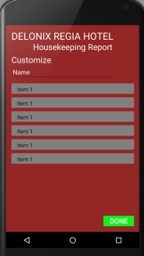
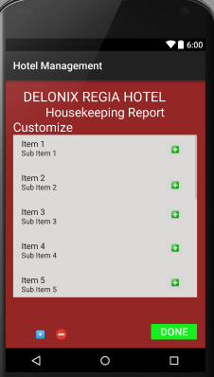
Customize Report Program Flow
--->
--->
--->
--->
--->
--->
Create Report Name and select all options. Clicked Done and Report is being Created.
Report is saved in the View Customize Class. Which this Interface allow Users to do CRUD.

Slide 5
Customize Report Benefits
Benefits:
Customize report for easy viewing
Save the settings/data
Personalize report

Slide 6
Customize Report Testing
Testing 1 :
Create Report -> Input Report Name -> Select All options -> Done Button to Save data/settings -> Customize Report Created

Slide 7
View Customize Report Testing
Testing 2:
Retrieve Report -> Select any saved report -> Redirect to report
Testing 3:
Edit Report -> Update settings
Testing 4:
Create Report -> Redirect to Create Customize Page

Slide 8
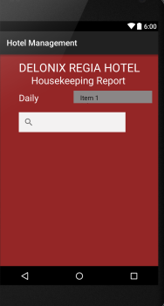
HouseKeeping Retrieve Report Benefits
Benefits:
Easy Filtering for types of room
Able to find specific Report Search

Slide 9
HouseKeeping Retrieve Report
Testing 5:
Display Daily Report -> Filter by Room Type -> Search for specific Report -> Found Individual data

Slide 10
Room Occupancy and Guest In Room Report
Chua Cheng Yu

Slide 11
Report Testing
Do unit testing to read codes and change it at the same time while running.
Easier to find out errors while running the software.
To read codes when running software so to know which codes is being executed.

Slide 12
Report Testing
Also to test each and different attributes in the software to ensure it is working.
Test that the data we type in each attributes is being saved in the database.
To test that it can generate a new report by displaying different data in the report.

Slide 13
Room Booking and availability System testing
Chloven Tan

Slide 14
Testing of the application
Test my code and changing my code frequently.
Adding code and testing at the same time.
Lesser errors.
Able to find errors early to prevent confusion.
Takes more time but safer.

Slide 15
Testing of the application
I use the testing with adding of variable into the listview.
I run and test the code each time i put it in the listview and database to check if there is any error.
This way, i can actually find any data type error or etc. for each of the datas i have to put in.
Much better with this test as i have alot of data
Each data is must not have any error.

Slide 16
Housekeeping System
Ngoh Man Ling

Slide 17
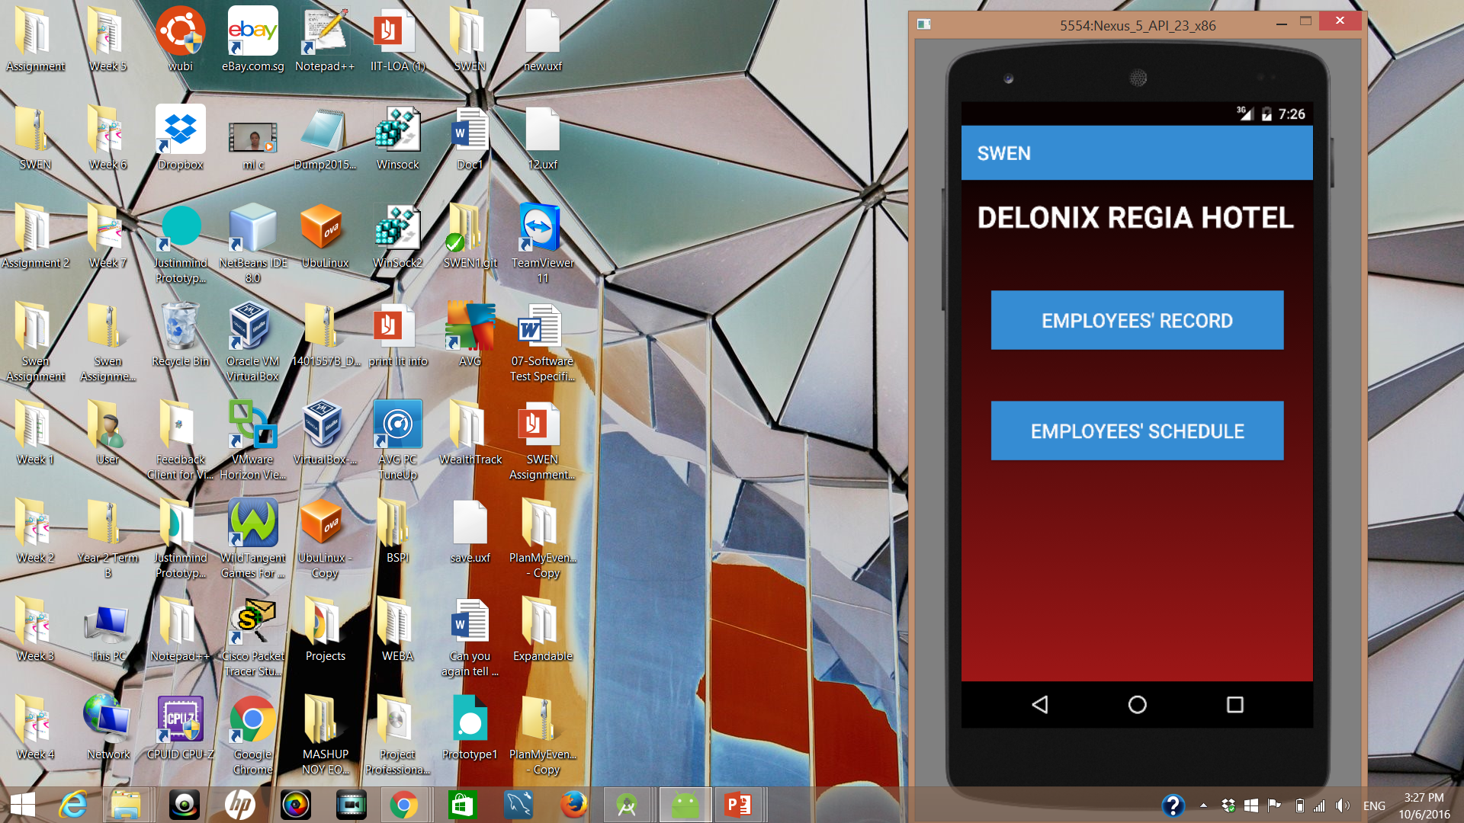
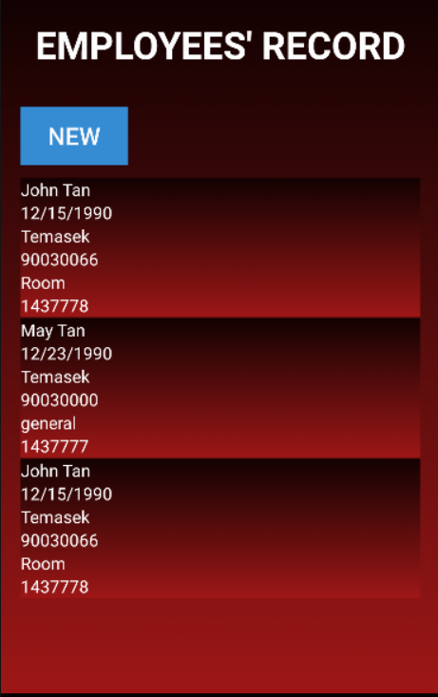
Housekeeping System
Consist of two parts:
Employee's record
Employee’s schedule
Function:
Retrieving of saved items and presenting it in list view
Creating new records/schedule
Updating/Deleting of items

Slide 18
Testing
Test when each function are implemented
Eg. when creating the delete function of listView
Application will be running in the android emulator
If function are not working or having errors, uses logcat to identify the issues.
Enable to identify the issues easily because application will be tested when each function is created

Slide 19
Integration of the whole system
To create the database and layout first
Lesser errors when integrate together
Everyone will have the same database
To integrate all of our parts together
After integrating, test for the function of every features in the application
Allows error to be resolved before implementation

